Slide 1

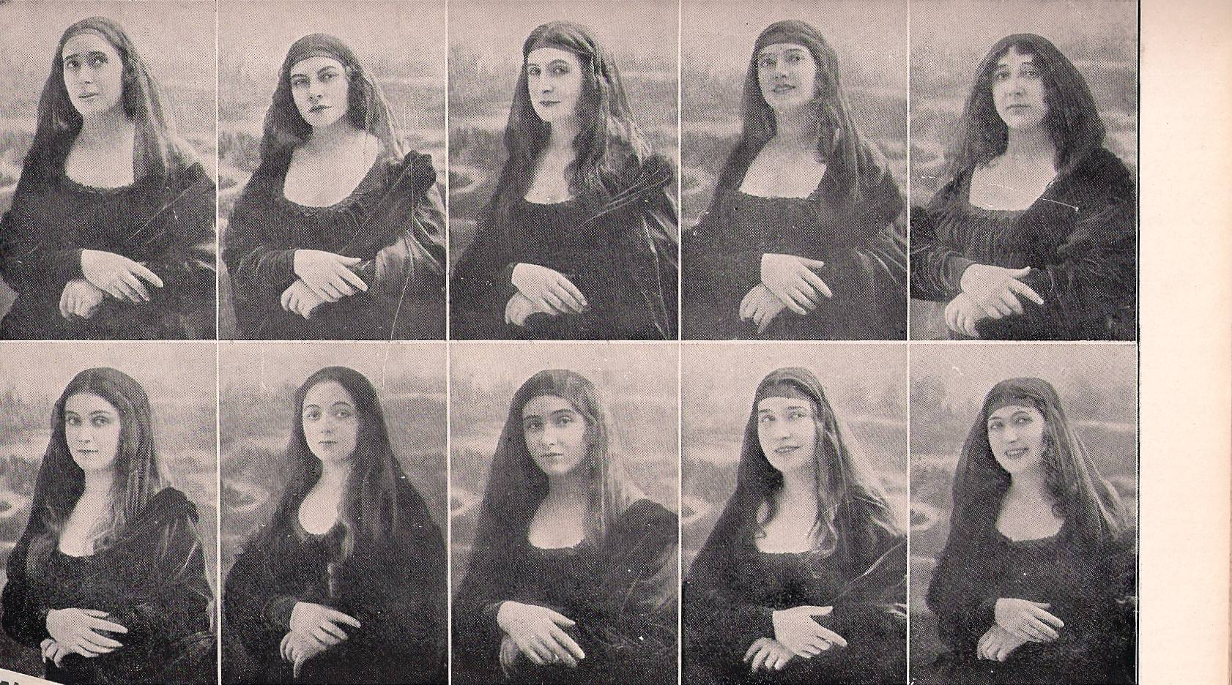
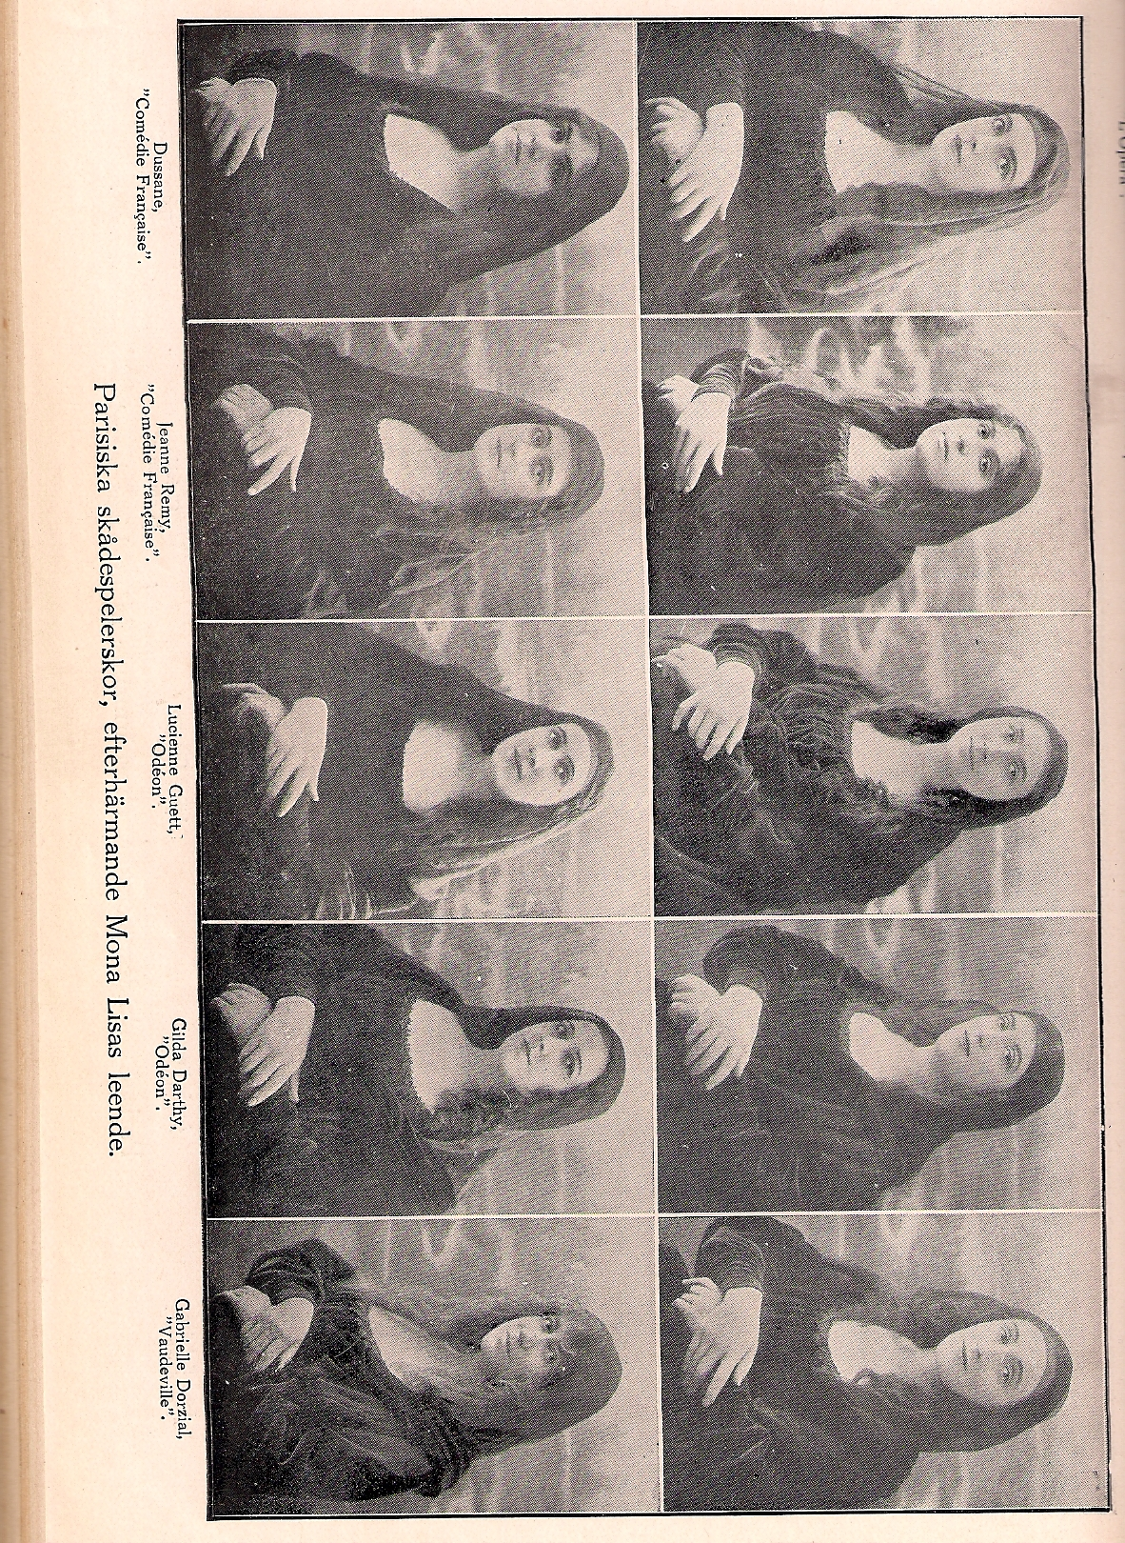
Crystal Chemistry of Modulated Structures

Slide 2
Disclaimer and copyright notice
Copyright 2010 Sven Lidin for this compilation.
This compilation is the collection of sheets of a presentation at the “International School on Aperiodic Crystals,“ 26 September – 2 October 2010 in Carqueiranne, France. Reproduction or redistribution of this compilation or parts of it are not allowed.
This compilation may contain copyrighted material. The compilation may not contain complete references to sources of materials used in it. It is the responsibility of the reader to provide proper citations, if he or she refers to material in this compilation.

Slide 3
Examples
1 Zn_{3-x}Sb₂
2 Stistaite
3 Onoratoite
4 Ba₂Cu₂Te₄O₁₁Br₂ and Ba₂Cu₂Te₄O_{11-d}(OH)_{2d}Br₂
5 Ca₂₈Ga₁₁
6 Re₁₃(Cd/Zn)_{~58}
7 ReGe_{2-x}

Slide 4
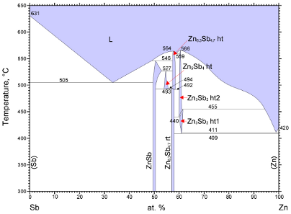
Zn_{3-x}Sb₂

Slide 5

Modulated structure
Orthorhombic:
7.2834, 15.3976, 25.0555 Å
q ≈ (0.385 0 0)
Pnaa(α00)0s0
Five boring Sb positions, one exciting Sb
Zn all over the place!
What is going on ?
Anders Jöns Ångström
1814-1874

Slide 6
Zn_{3-x}Sb₂
L
K
L
L
Sb6

Slide 7
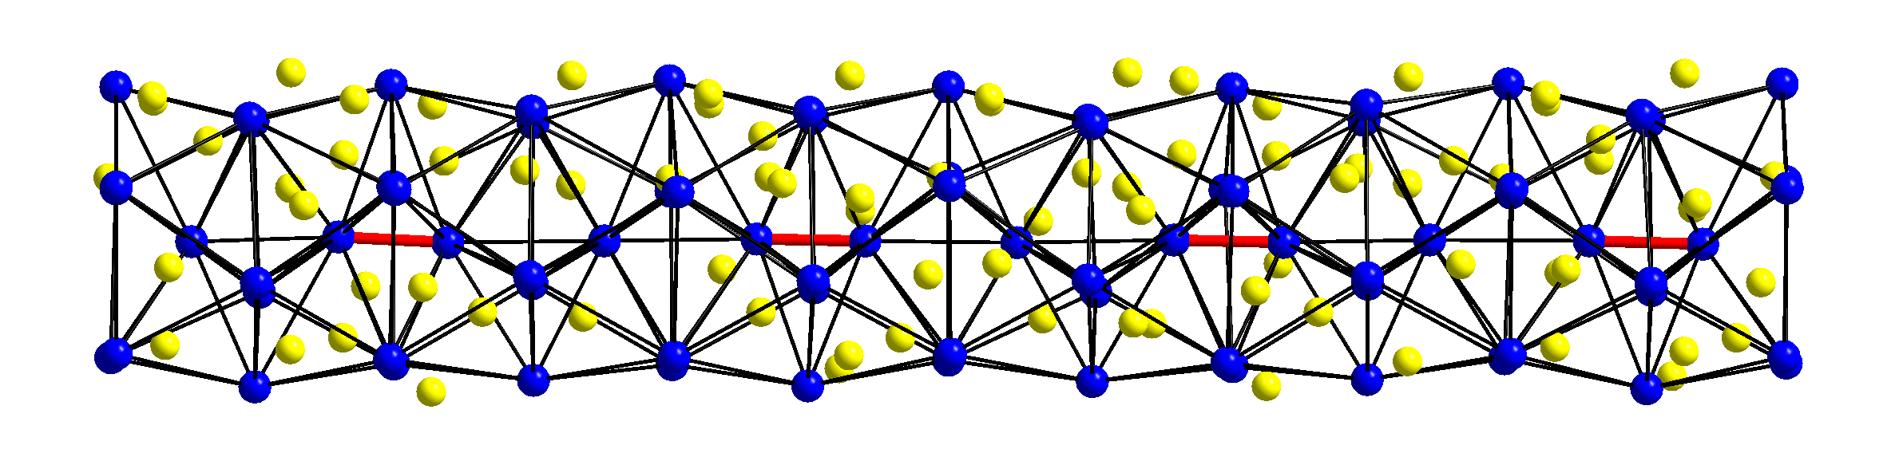
Sb³⁻, Sb₂⁴⁻
4.00 4.00 2.95 4.00 4.00 Å
Zintl-pair formation in a pentagonal column

Slide 8
Sb-Sb distances
Sb³⁻
Sb6-Sb6
Sb₂⁴⁻

Slide 9
Examples
1 Zn_{3-x}Sb₂
2 Stistaite
3 Onoratoite
4 Ba₂Cu₂Te₄O₁₁Br₂ and Ba₂Cu₂Te₄O_{11-d}(OH)_{2d}Br₂
5 Ca₂₈Ga₁₁
6 Re₁₃(Cd/Zn)_{~58}
7 ReGe_{2-x}

Slide 10
How exciting is Sb-Sn?
Sb
Sn

Slide 11
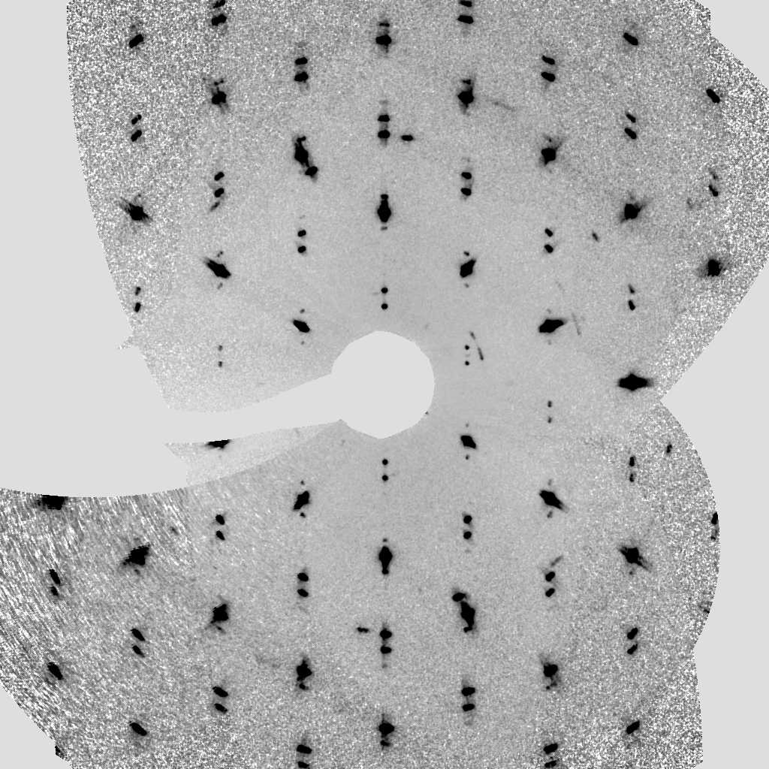
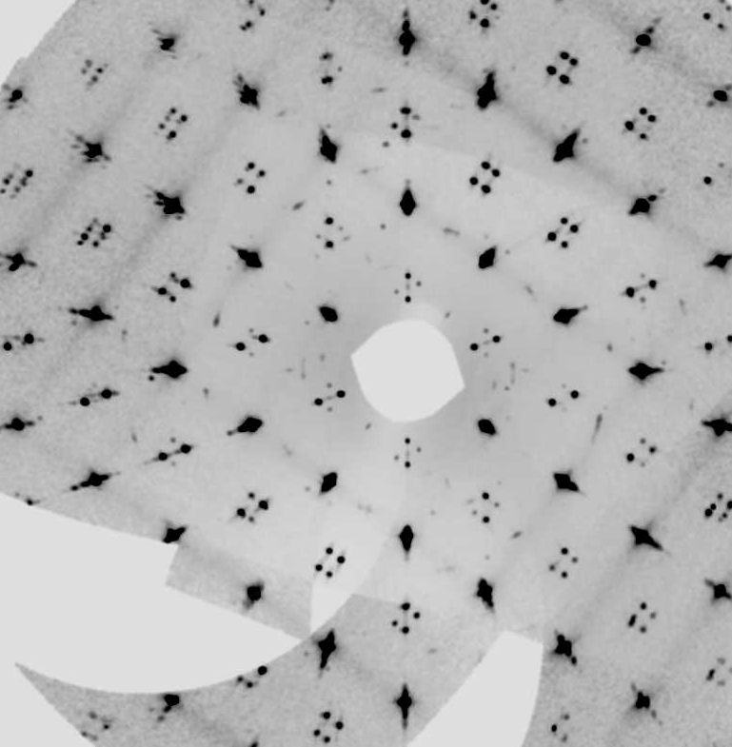
Diffraction from Sb-Sn

Slide 12
Diffraction from Sb-Sn
q≈(0 0 1.35)

Slide 13
Questions of crystal chemistry:
1) What is the structure of Stistaite?
2) What is all the garbage in Sn-rich Stistaite?

Slide 14
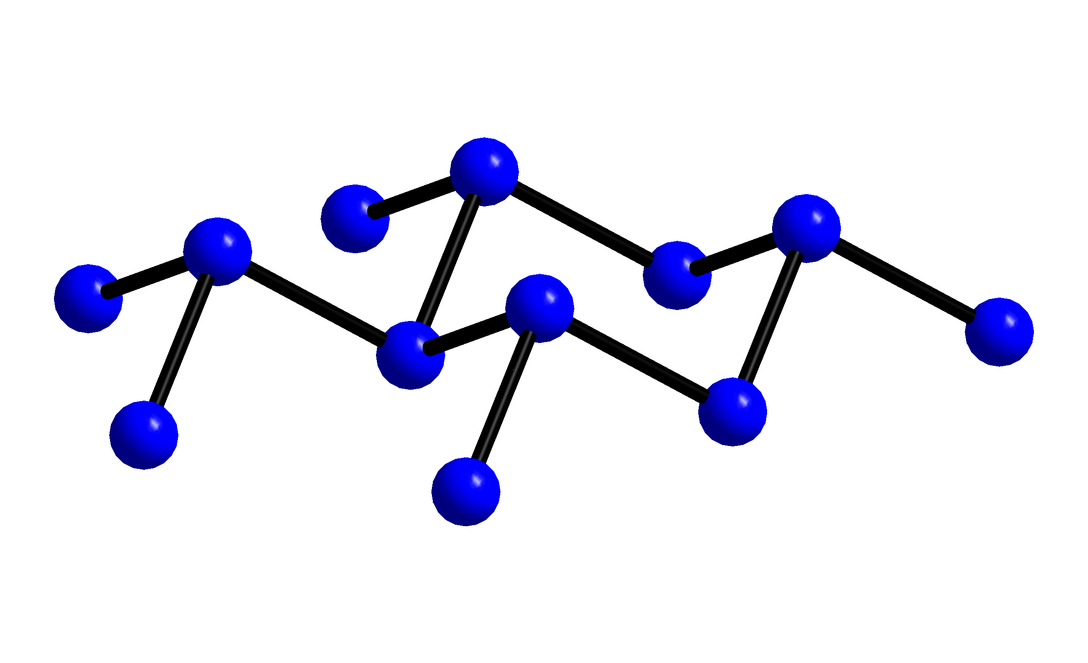
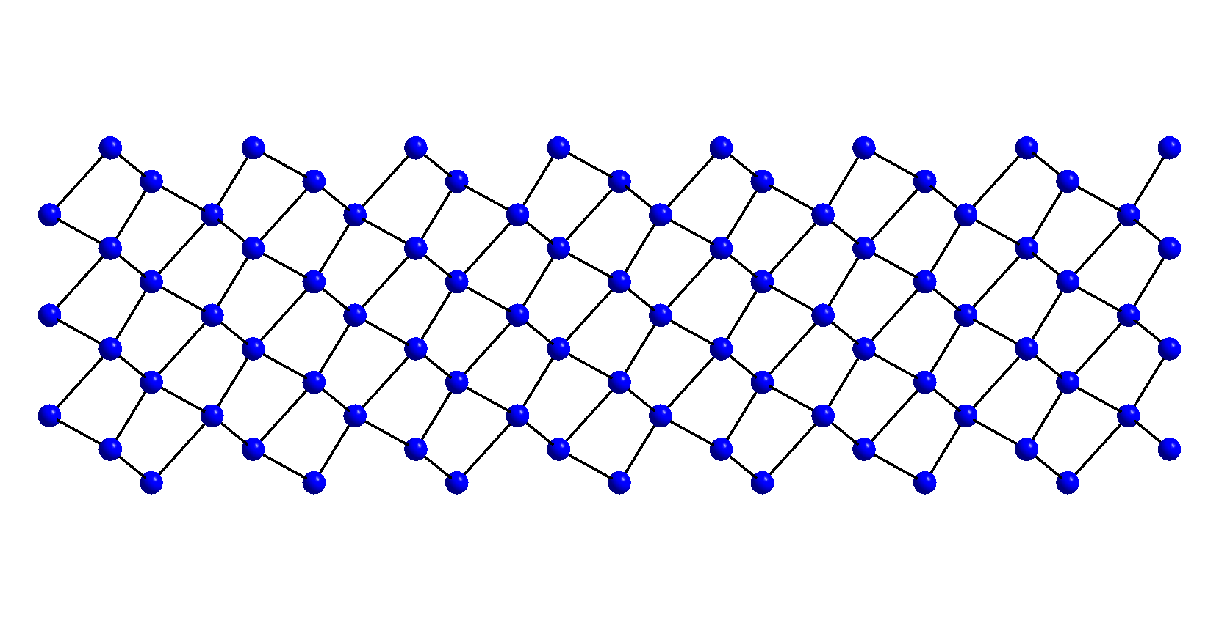
What is the structure of Stistait? Das Urstoff Sb! Each Sb is 3-bonded to yield a full octet

Slide 15
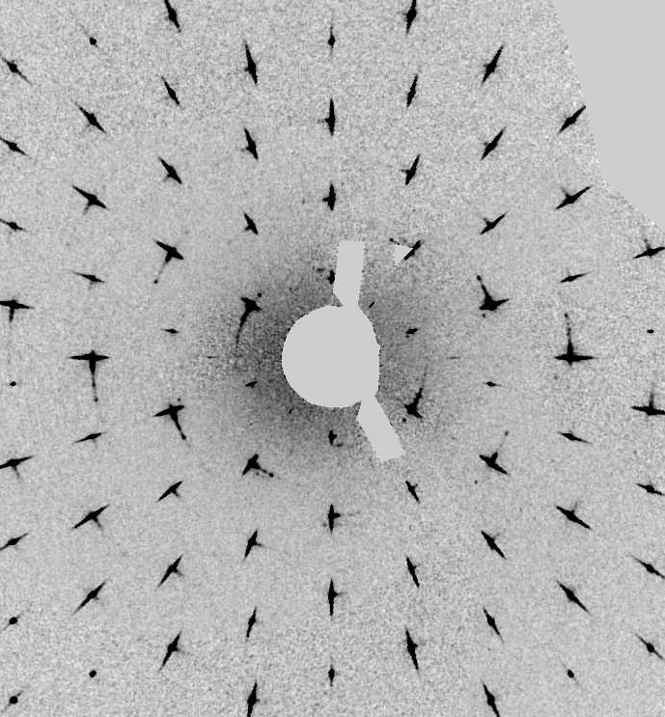
Das Urstoff Sb - diffraction
q=(0 0 1.5)
Sb is a doubled PC struture. The effect is very strong, an it is difficult to distinguish between main reflections and satellites. The effect is purely displacive.

Slide 16
Symmetry/Cell
R-3m(00γ)00
Sb :a=4.310 c=5.640 q=(0,0,1.50)
Sb₂Sn :a=4.329 c=5.412 q=(0,0,1.37)
Sb₃Sn₄ :a=4.340 c=5.312 q=(0,0,1.29)
γ=3/2(1-[Sn]/4) [Sn]=4(1-2γ/3)

Slide 17
It’s could be all the same
q
q=1.36
Sn content

Slide 18
One discontinuous phase

Slide 19
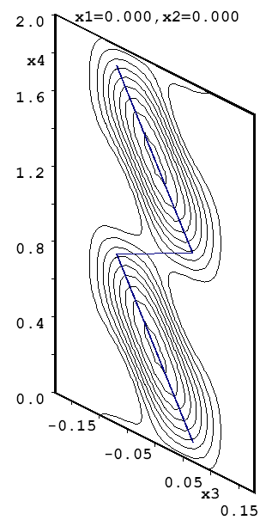
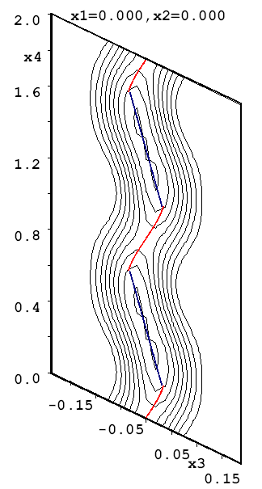
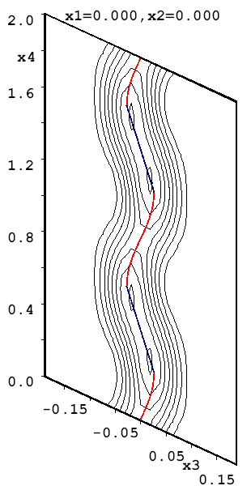
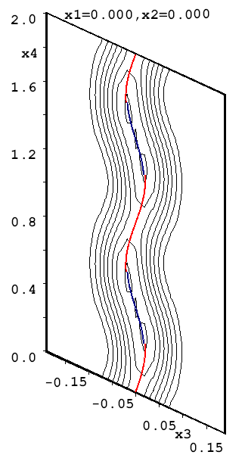
It’s all the same
δ=0.070
0.035
0.030
0.025
0 34 53 57 %Sn

Slide 20
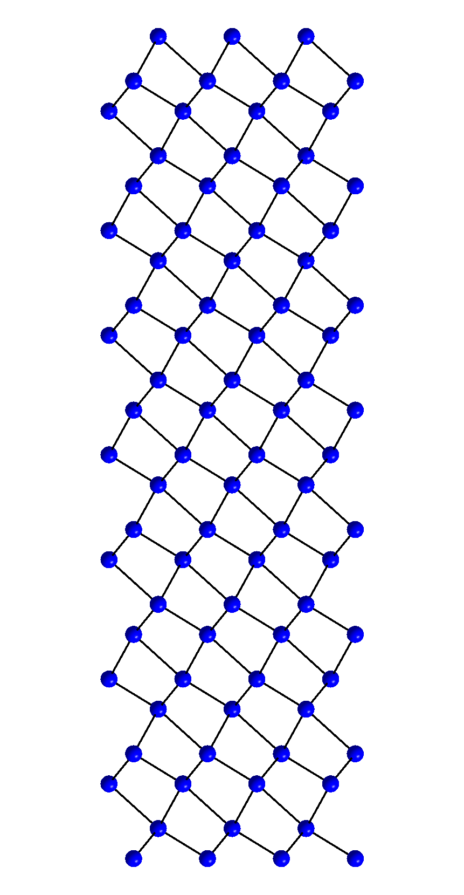
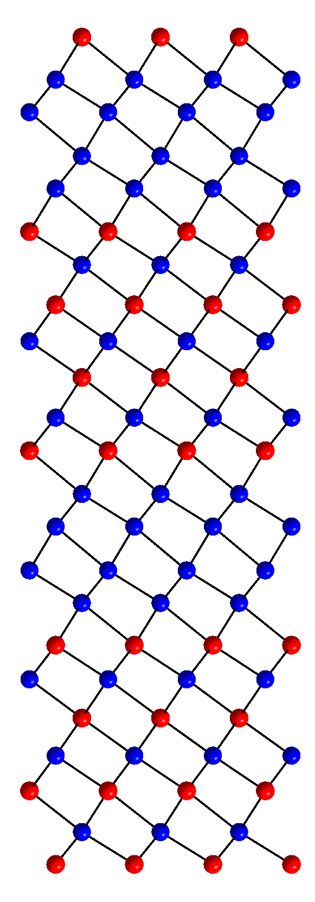
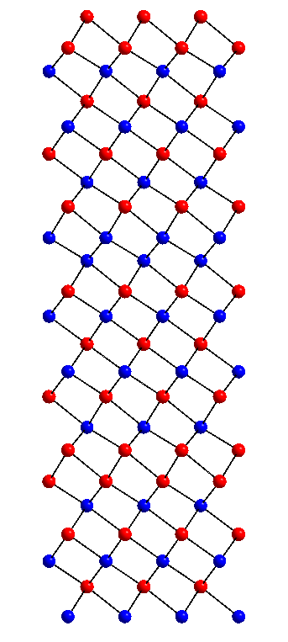
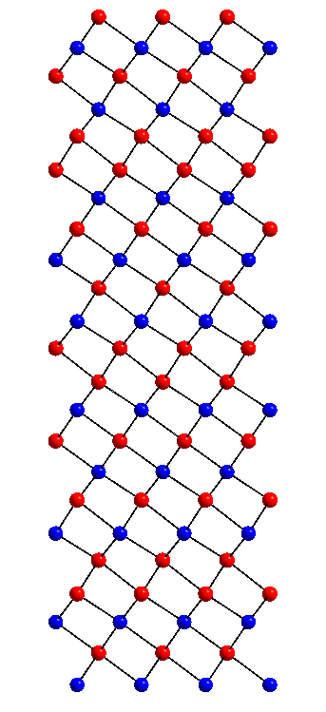
It’s all the same
Miscibility gap 13-34%
0 34 53 57 %Sn

Slide 21
Solid solution
13% Sn

Slide 22

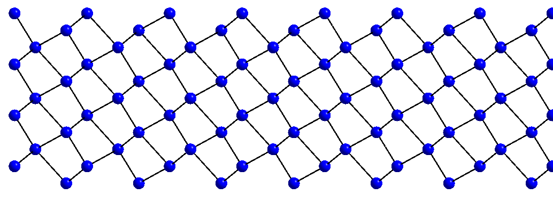
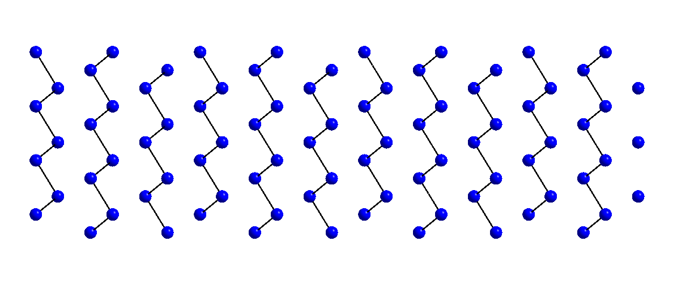
Solid solution

Slide 23
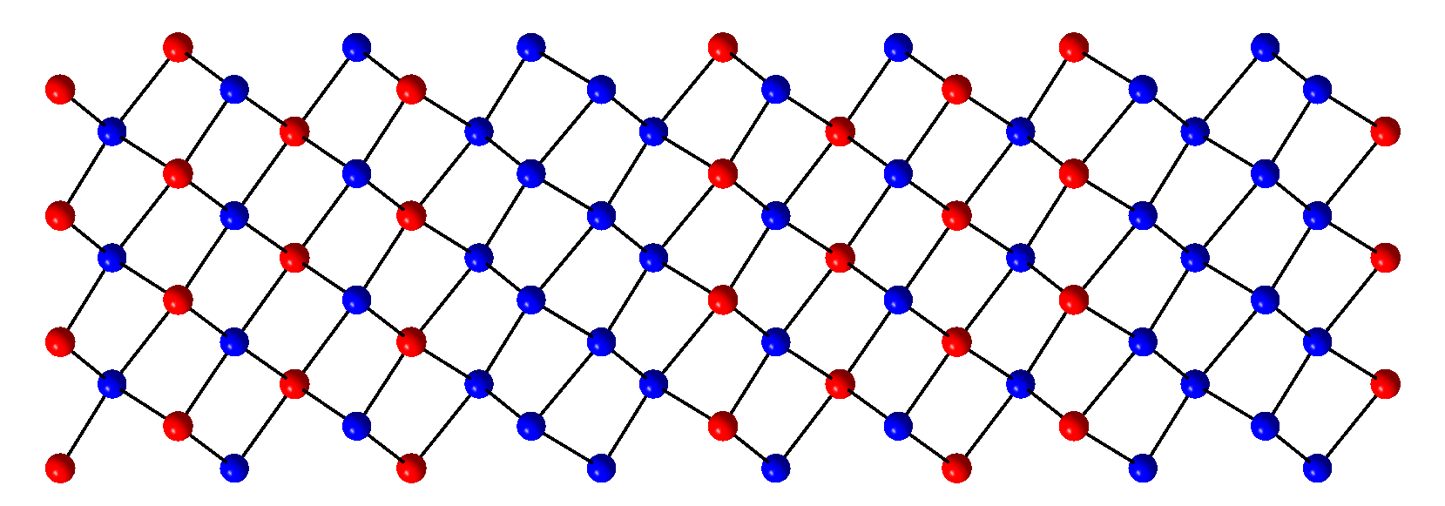
Solid solution
Sb₃Sn₄
Sb
13% Sn =Sb₃Sn₄ + 21Sb

Slide 24
2) What is all the garbage in Sn-rich Stistaite?
Twin’n’Sn!
Stistaite
α-Sn
α-Sn
Strain
λ half

Slide 25
Composite diffraction pattern
Sn
SbSn

Slide 26
Examples
1 Zn_{3-x}Sb₂
2 Stistaite
3 Onoratoite
4 Ba₂Cu₂Te₄O₁₁Br₂ and Ba₂Cu₂Te₄O_{11-d}(OH)_{2d}Br₂
5 Ca₂₈Ga₁₁
6 Re₁₃(Cd/Zn)_{~58}
7 ReGe_{2-x}

Slide 27
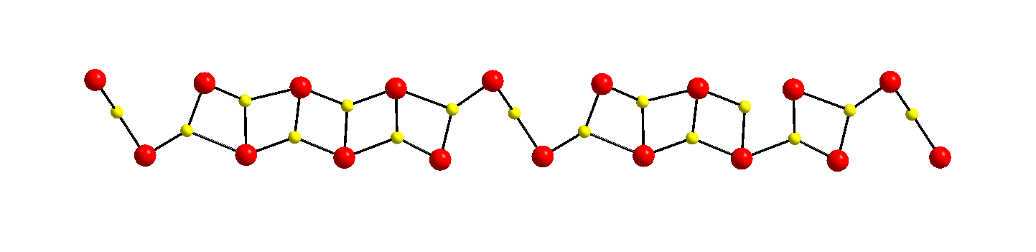
Onoratoite
In each column, oxygen vacancies order to form a fourfold superstructure along b.
Cl-onoratoit has q = 0 ¼ 0 while for I-onoratoit q ≈ ½ ¼ ¹/₆

Slide 28
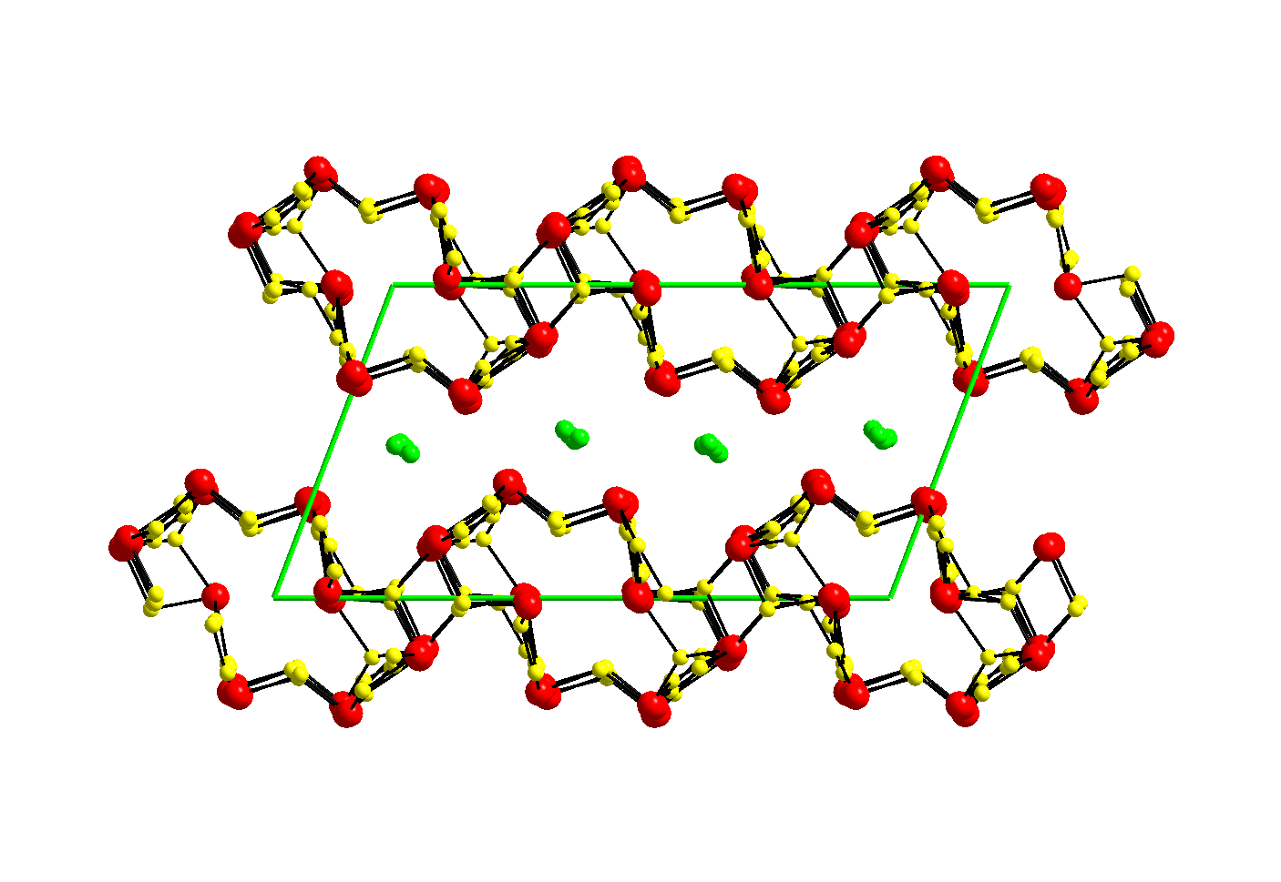
Onoratoite

Slide 29
Onoratoite
Strategy for structural solution:
Take super structure from Cl-Onoratoite, covert to modulated structure q=(¾ ¼ 0)
Reduce symmetry to triclinic, use parameters as starting model for I-Onoratoite q≈(0.5 0.25 0.16)
Refine. Very small change.

Slide 30
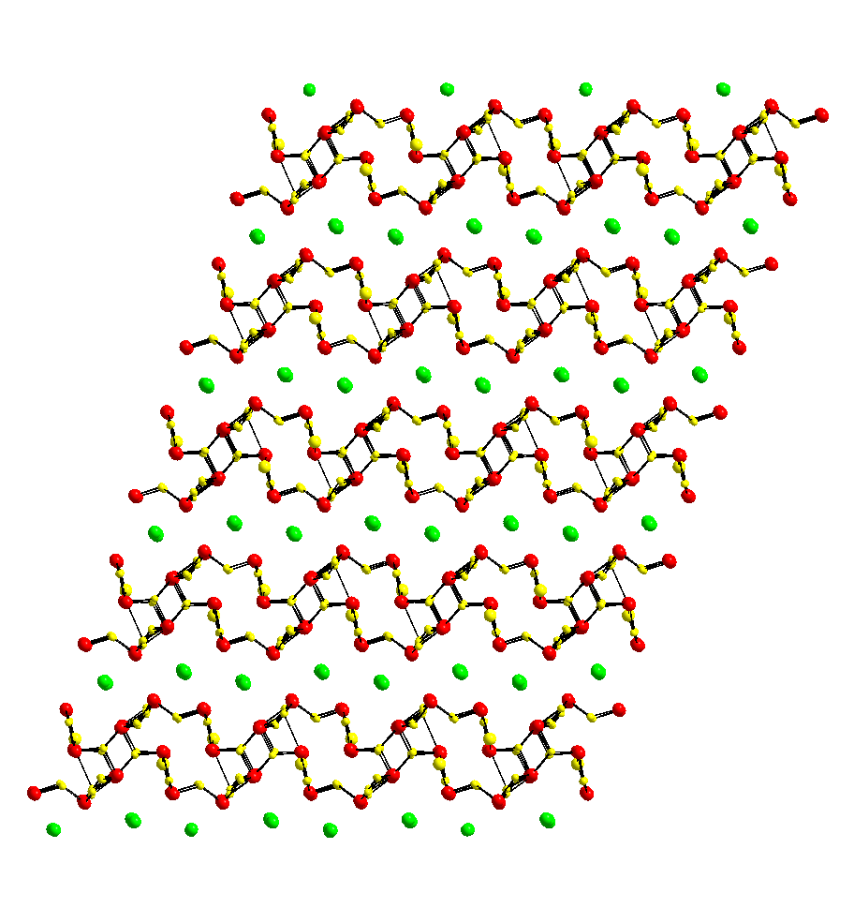
Onoratoite
I
Cl

Slide 31
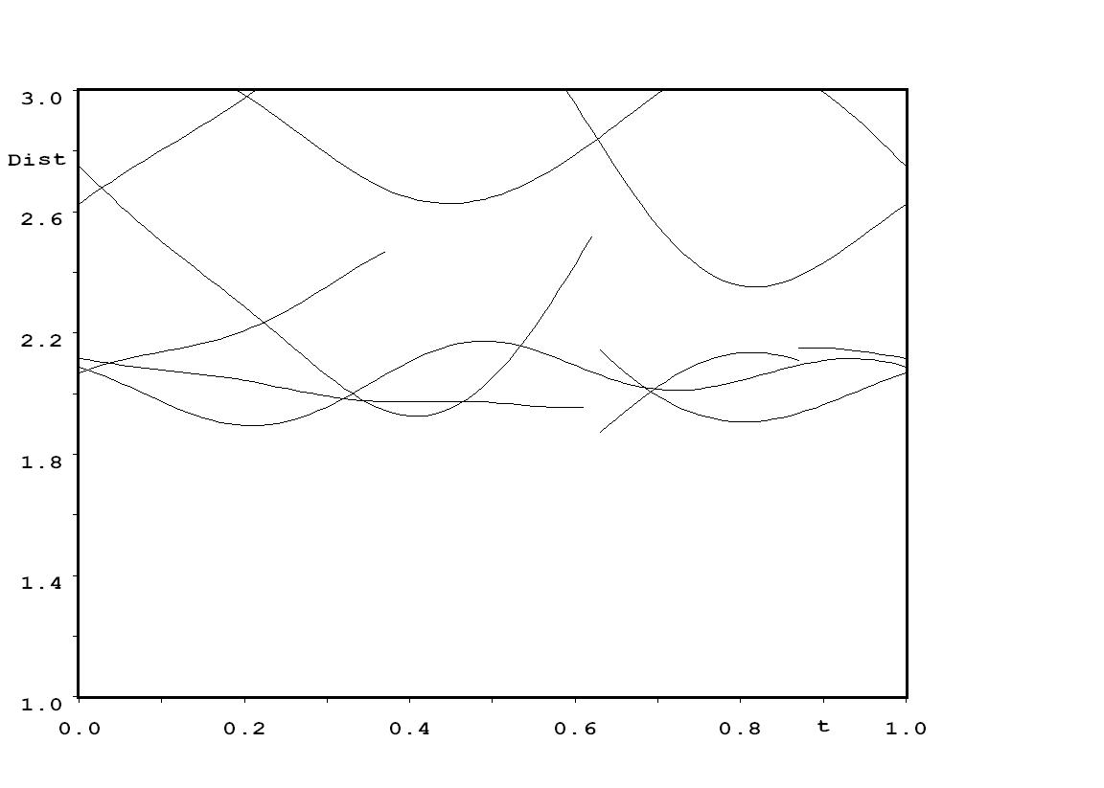
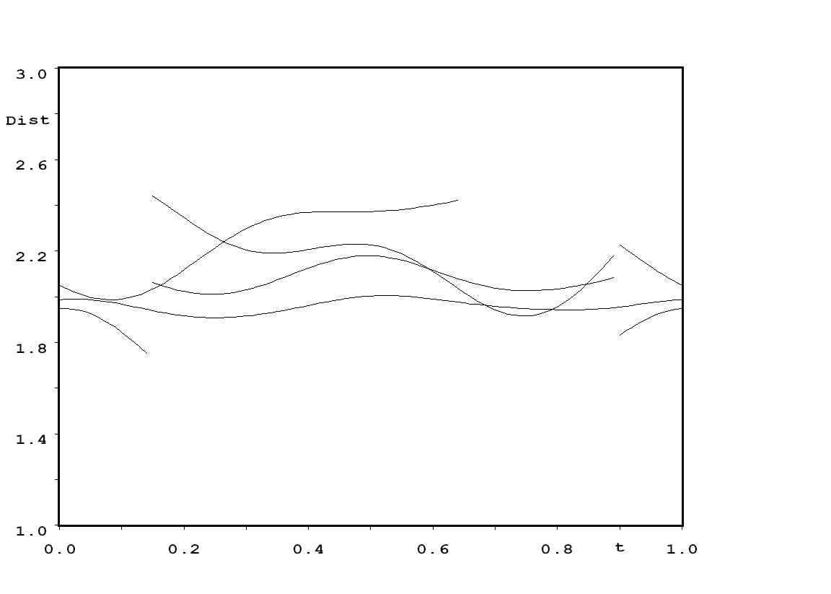
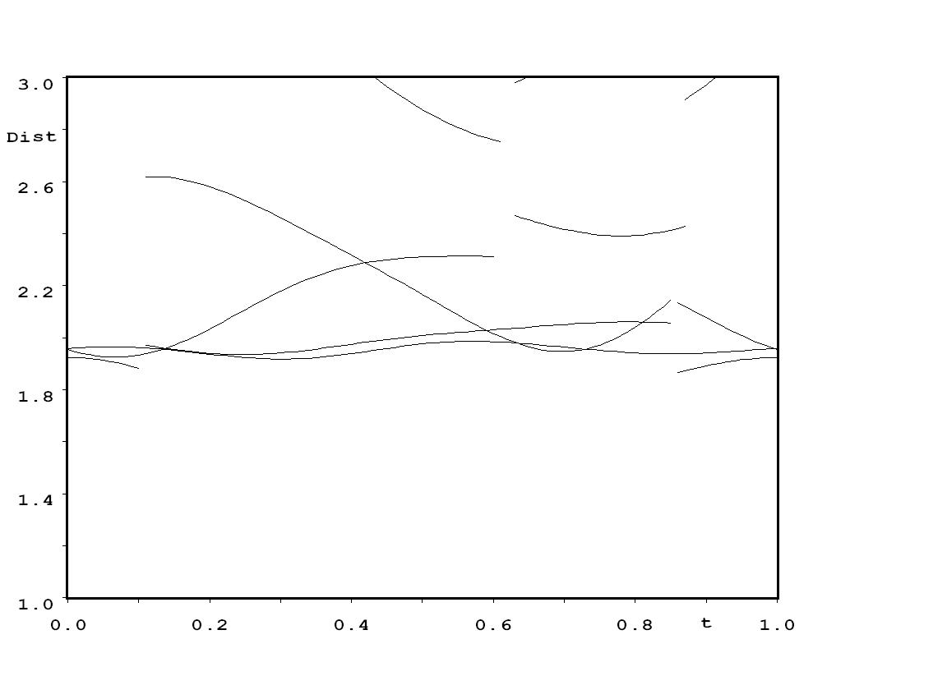
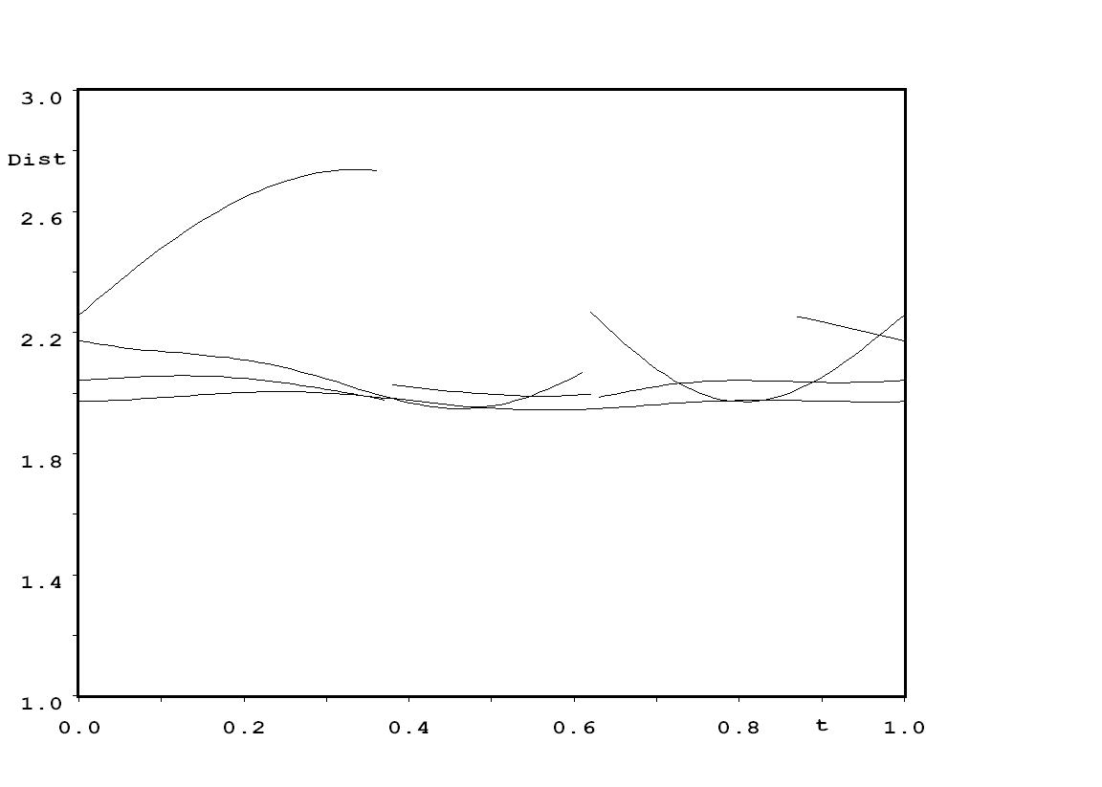
t-map of Sb-O distances

Slide 32
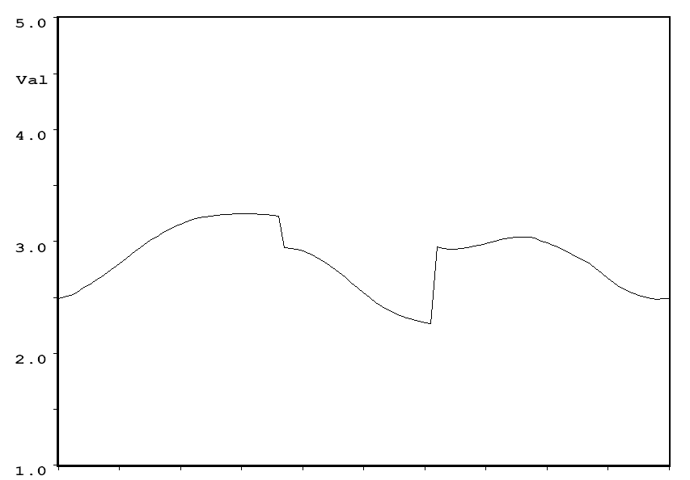
t-map of BVS of Sb1

Slide 33
Examples
1 Zn_{3-x}Sb₂
2 Stistaite
3 Onoratoite
4 Ba₂Cu₂Te₄O₁₁Br₂ and Ba₂Cu₂Te₄O_{11-d}(OH)_{2d}Br₂
5 Ca₂₈Ga₁₁
6 Re₁₃(Cd/Zn)_{~58}
7 ReGe_{2-x}

Slide 34
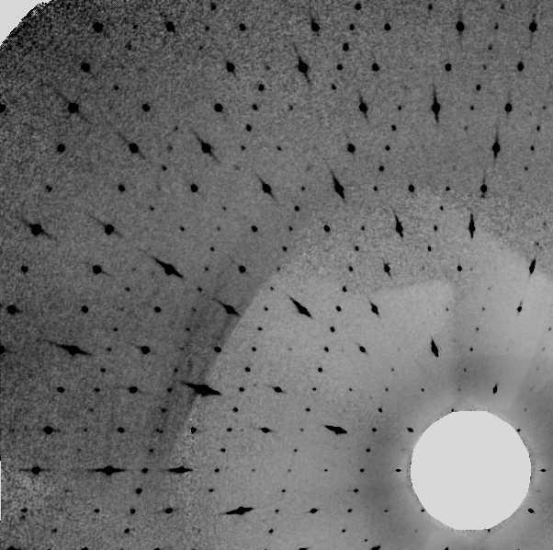
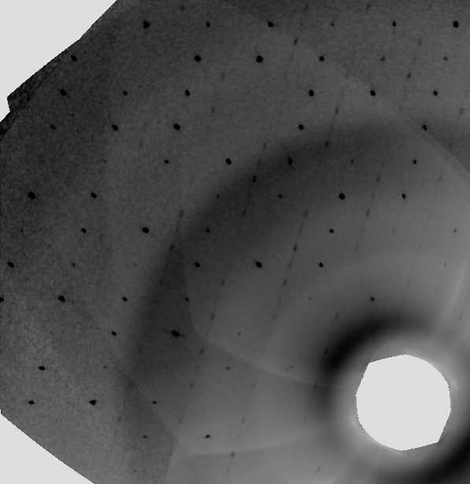
Projections h0l +h1l. Normal left. Modulated right

Slide 35
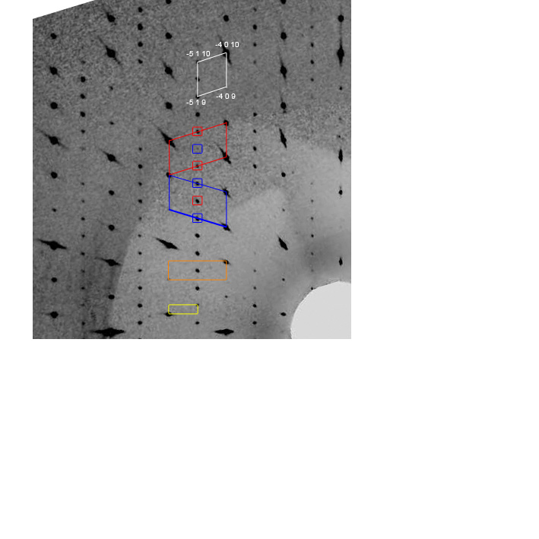
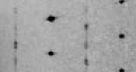
Note the splitting below

Slide 36
Interpretation of the pattern for the normal compound
Twinned cell used in refinement, C2/m =>C-1
Twin induced superstructure, Fdd2
Fundamental cell, Bmmb

Slide 37
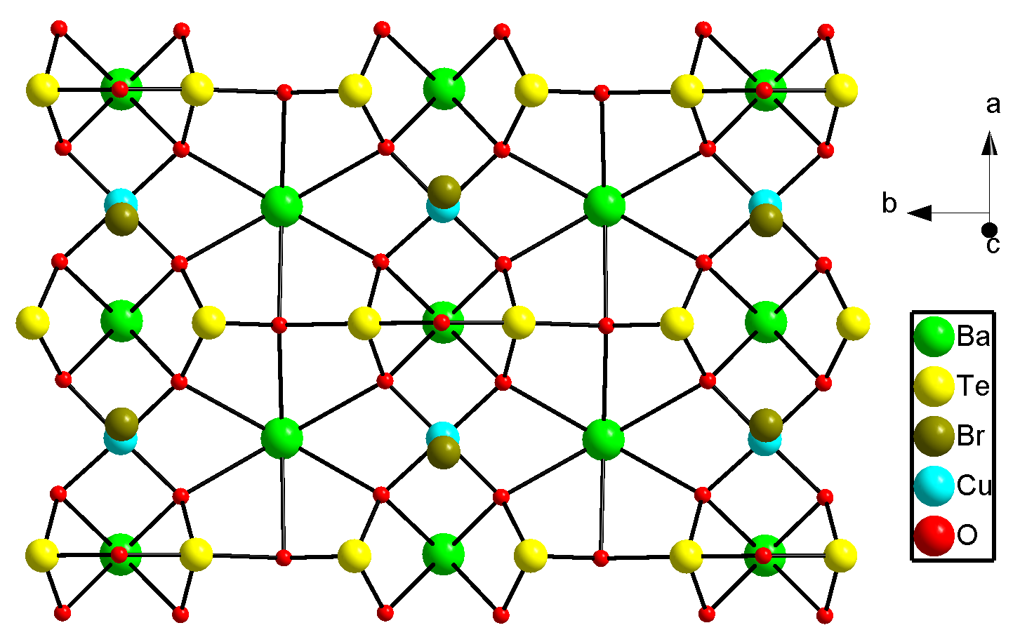
Cause of super structure – O11- Effect Br

Slide 38
But…
The compound is (slightly) unstable in air, and a sample left in contact with moisture loses the sharp super structure reflections to diffuse streaks.
A sample sealed under ambient conditions shows an incommensurate modulation,
q≈ (0 0 1/16)
instead of the superstructure reflections.

Slide 39
Modulation
O11 Br

Slide 40
Exchange of O for OH

Slide 41
Distances Br-O
Br-O
Br-H-O

Slide 42
Examples
1 Zn_{3-x}Sb₂
2 Stistaite
3 Onoratoite
4 Ba₂Cu₂Te₄O₁₁Br₂ and Ba₂Cu₂Te₄O_{11-d}(OH)_{2d}Br₂
5 Ca₂₈Ga₁₁
6 Re₁₃(Cd/Zn)_{~58}
7 ReGe_{2-x}

Slide 43
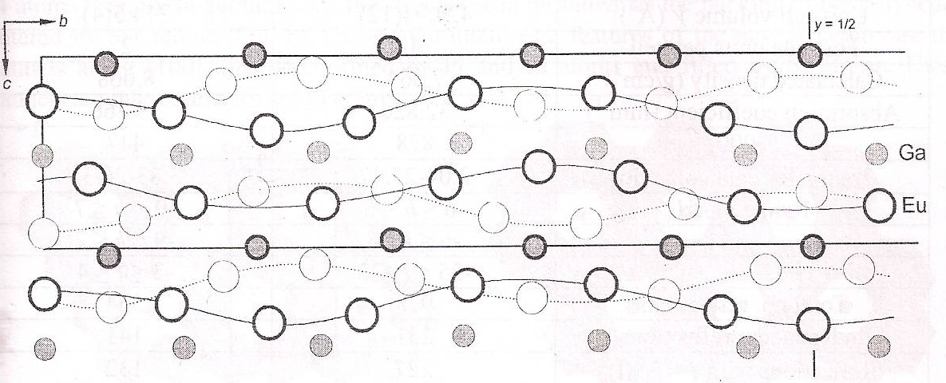
Memories of Lviv (Lvov, Lwow, Lemberg, Leopolis)

Slide 44
Ca₂₈Ga₁₁
Imm2, a=5.324Å, b=61.445Å,c=7.488Å
15 Ca positions, 6 Ga positions

Slide 45
Composite?
Yes, a single Ga position and one Ca.
Xmmm(0β0)00s, β=0.2727=3/11
a=5.324Å, b=4.7265Å,c=7.488Å, 38 parameters (60)
Ca₂₈(Ga,Ge)_{11-x} ?

Slide 46
Examples
1 Zn_{3-x}Sb₂
2 Stistaite
3 Onoratoite
4 Ba₂Cu₂Te₄O₁₁Br₂ and Ba₂Cu₂Te₄O_{11-d}(OH)_{2d}Br₂
5 Ca₂₈Ga₁₁
6 Re₁₃(Cd/Zn)_{~58}
7 ReGe_{2-x}

Slide 47

Hexagonal Approximants in the Re₁₃(Cd/Zn)_{~58} Systems
The Good, The Bad and the Ugly

Slide 48
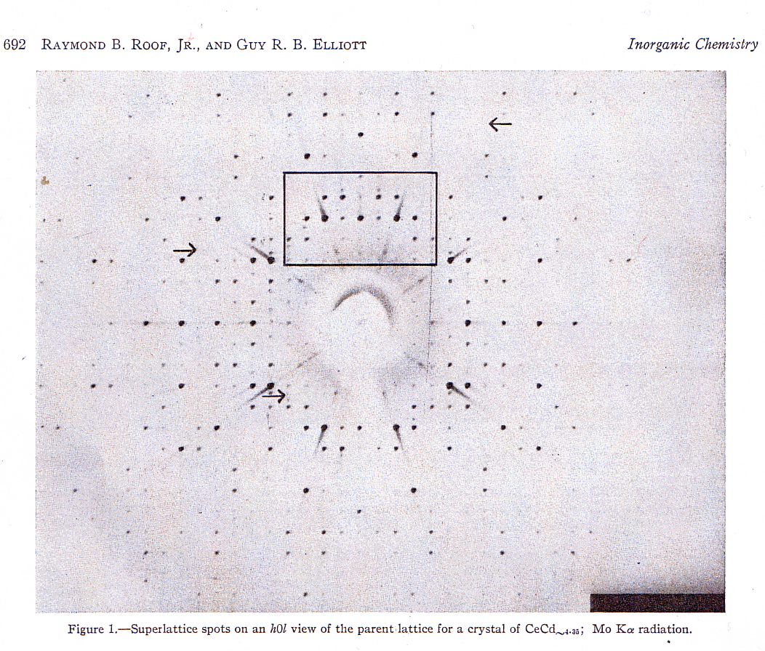
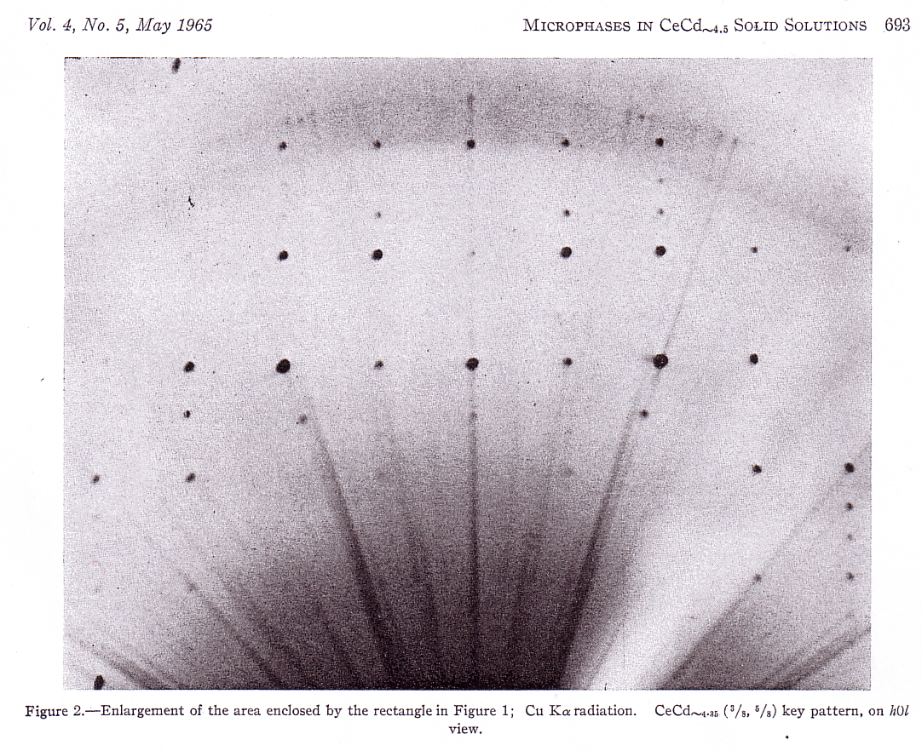
CeCd_{~4.5}

Slide 49
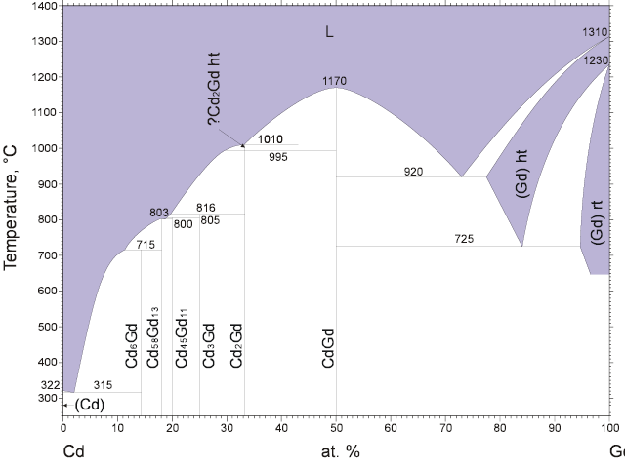
Typical Constitution Diagram

Slide 50
Hexagonal structures Zn
RE Radius S.G
Eu 204 -------
Yb 194 P6₃/mmc (+ Pc)
La 188 ?
Pr 183 P6₃/mmc
Ce 182.5 P6₃/mmc
Nd 182 P6₃/mmc
Pm 181 ?????
Y 181 ?
Sm 180 P6₃/mmc
Gd 180 P6₃/mmc + P2₁
Tb 178 P6₃mc + P2₁
Dy 177 Pnma
Ho 177 Pnma + Inc
Er 176 Pc2₁n
Tm 175 Pc2₁n
Lu 173 Pc2₁n
Note:
S.G. determination from satellites, absences and/or failure to refine

Slide 51
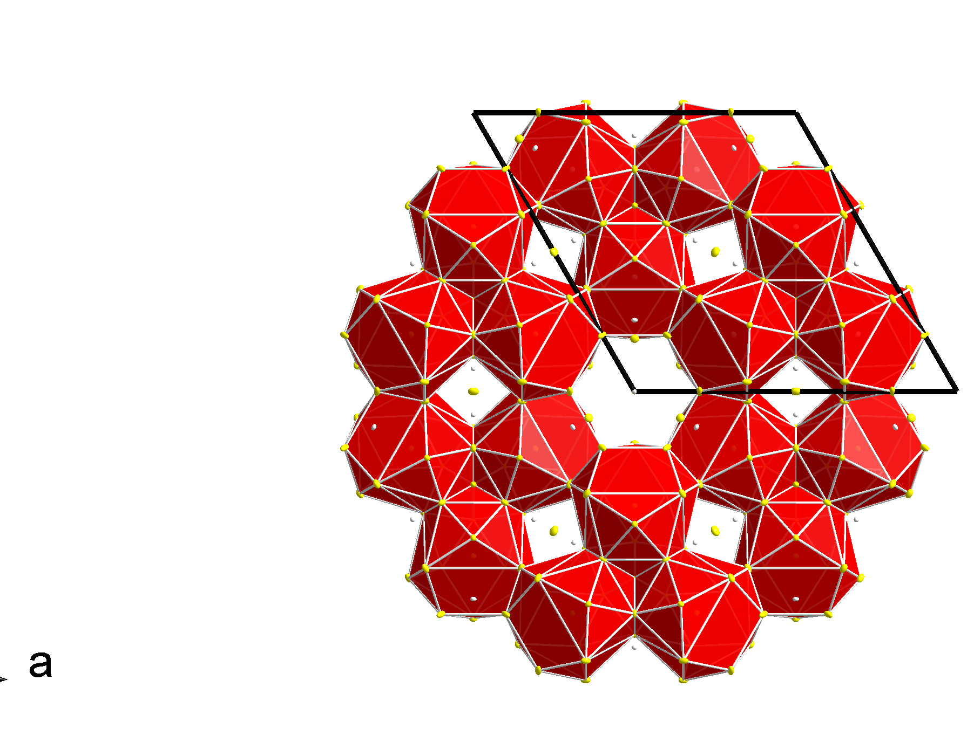
Complex basic structure

Slide 52
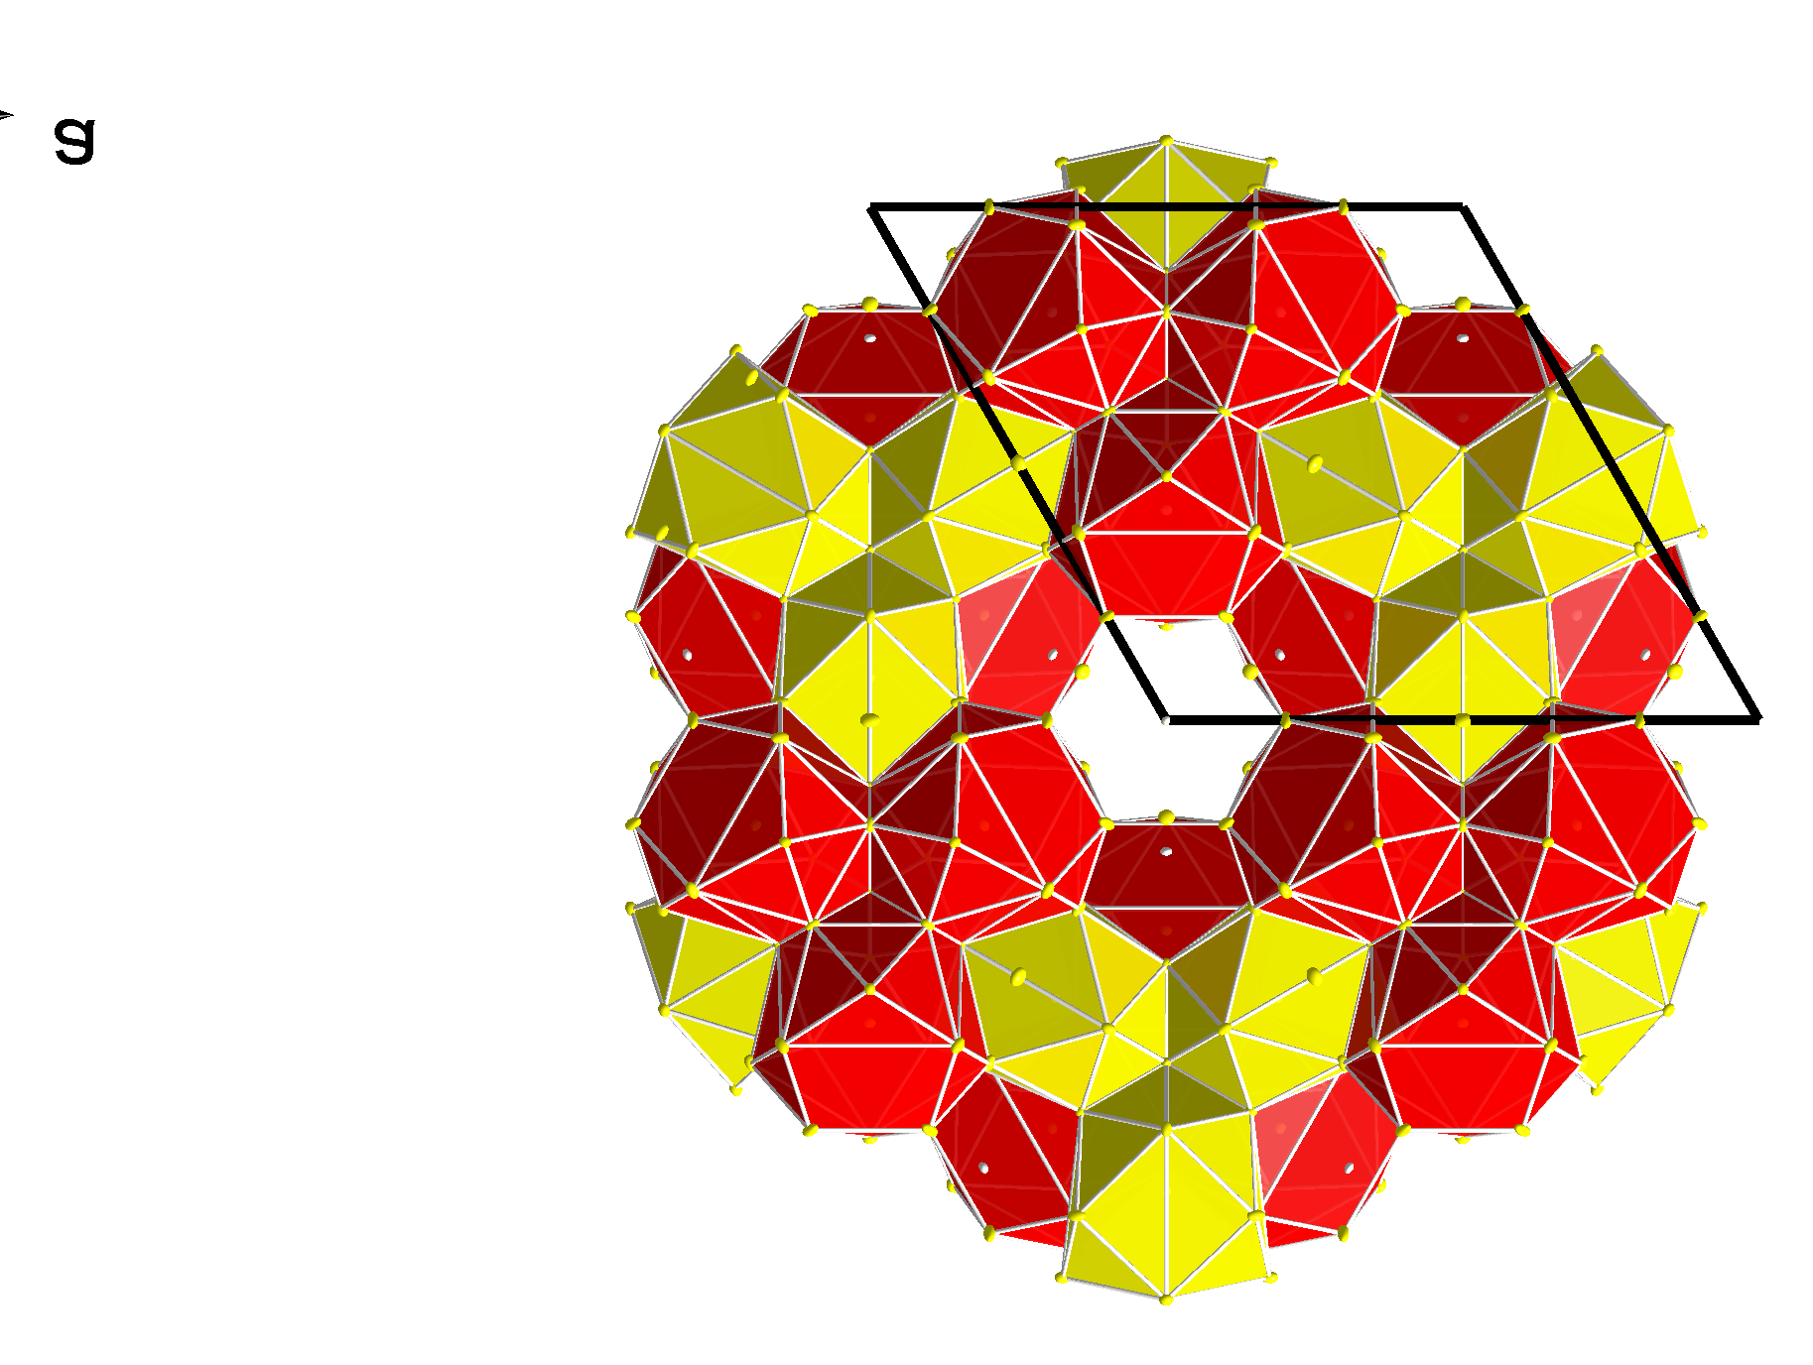
Complex basic structure

Slide 53
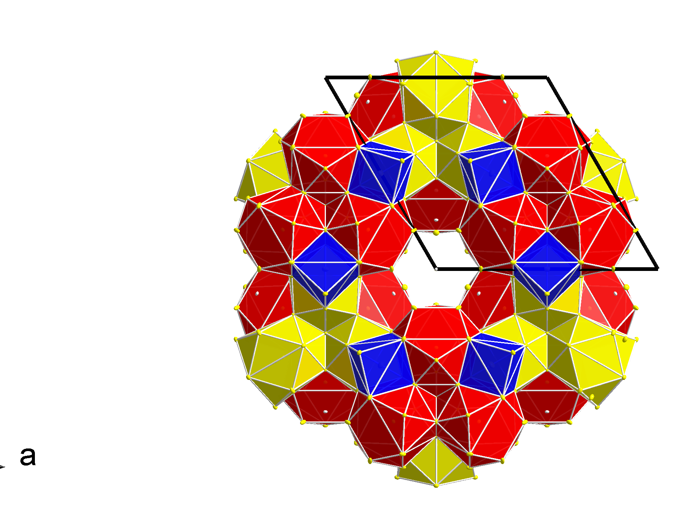
Complex basic structure

Slide 54
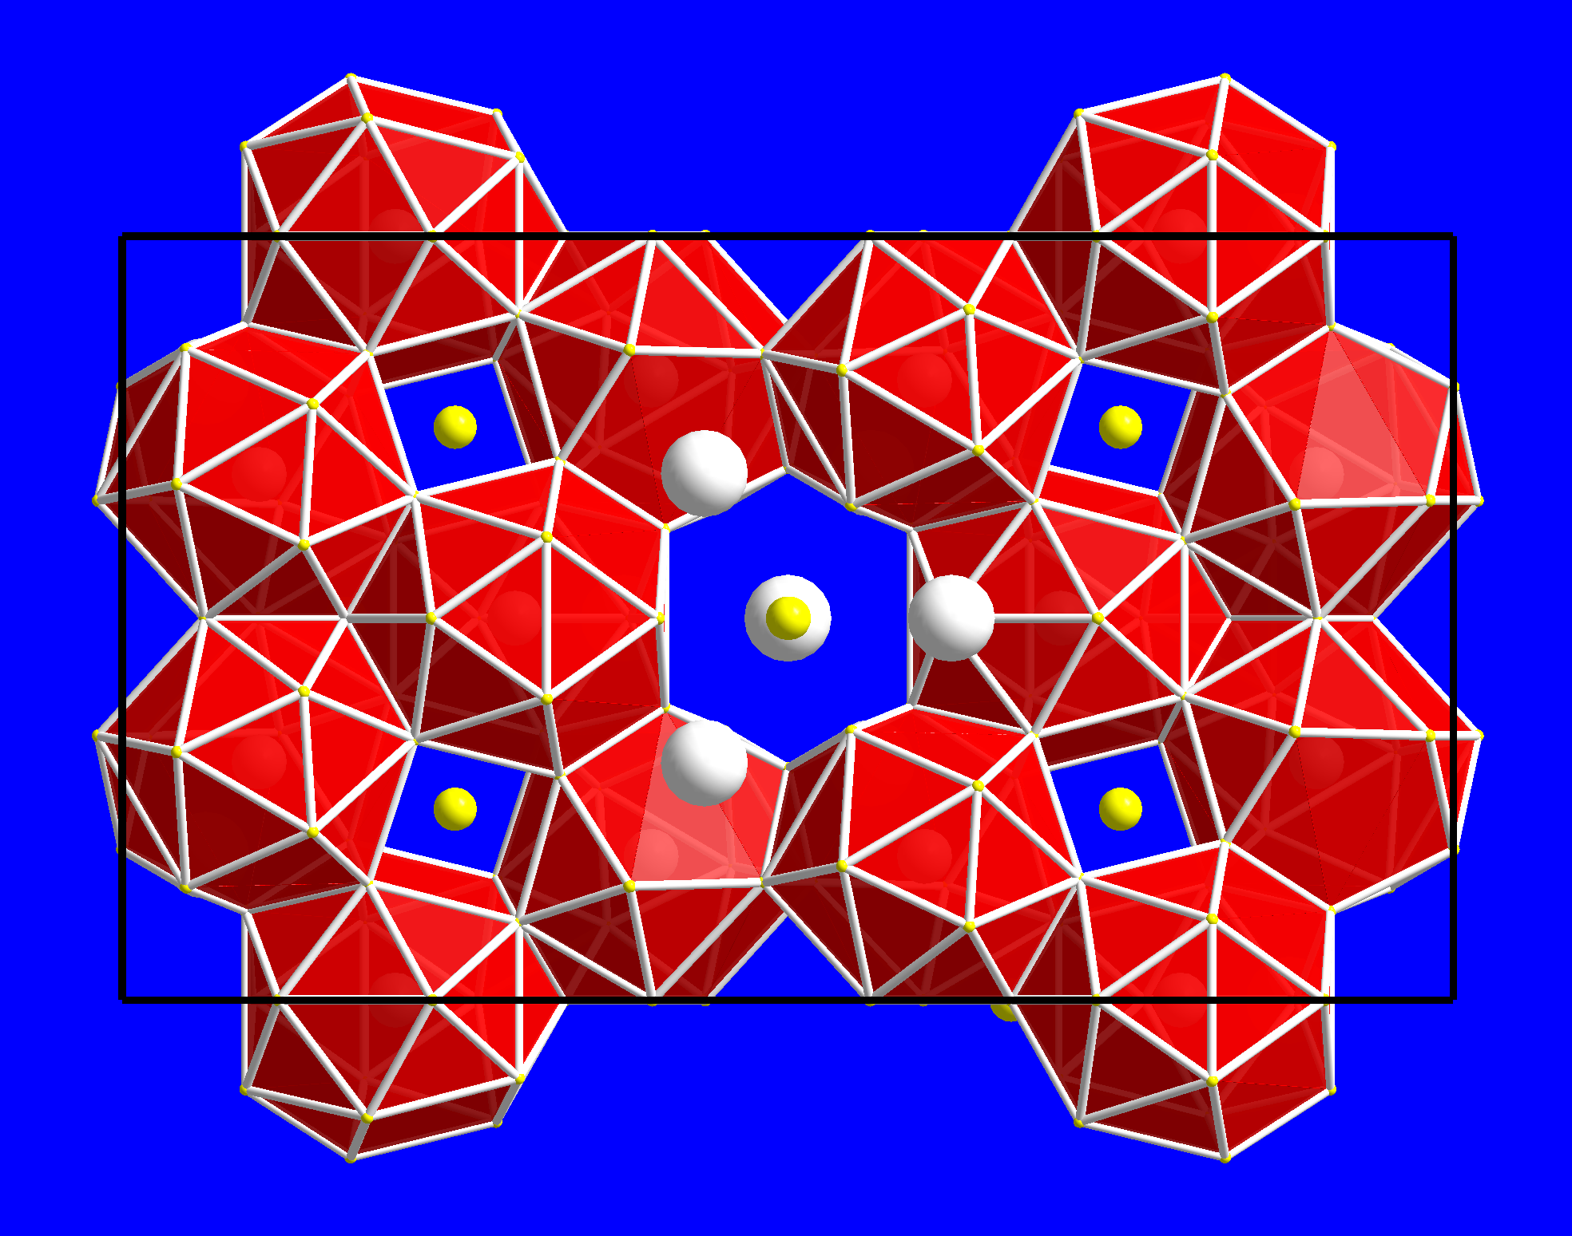
Complex basic structure

Slide 55
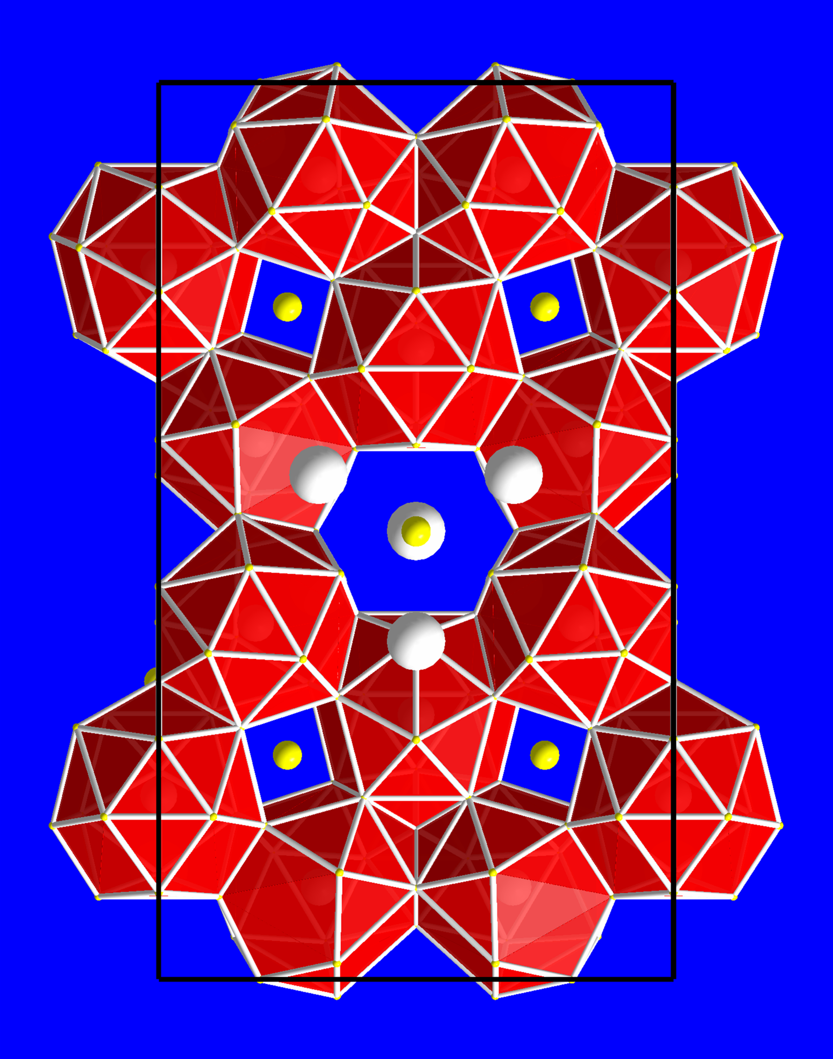
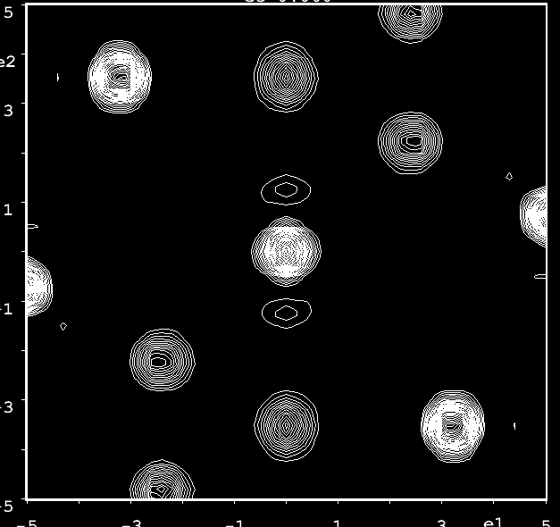
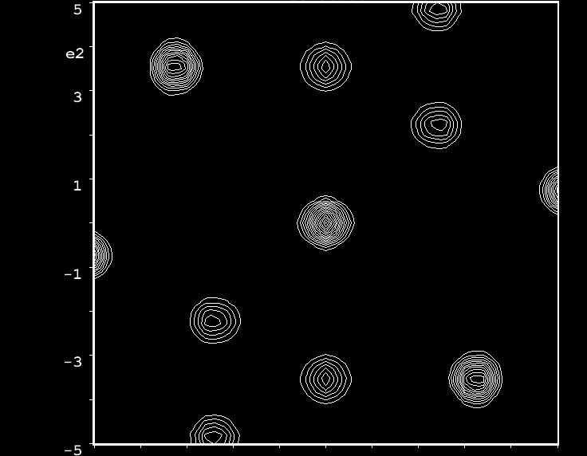
Exchange mechanism I
Nd
Ce

Slide 56
Exchange mechanism I
For Ce and Pr no exchange is found. For Nd it is found to some degree to make the composition Nd_{12.8}Zn_{58.4}.
For Yb, Sm, Gd and Tb it is found together with exchange mechanism II

Slide 57
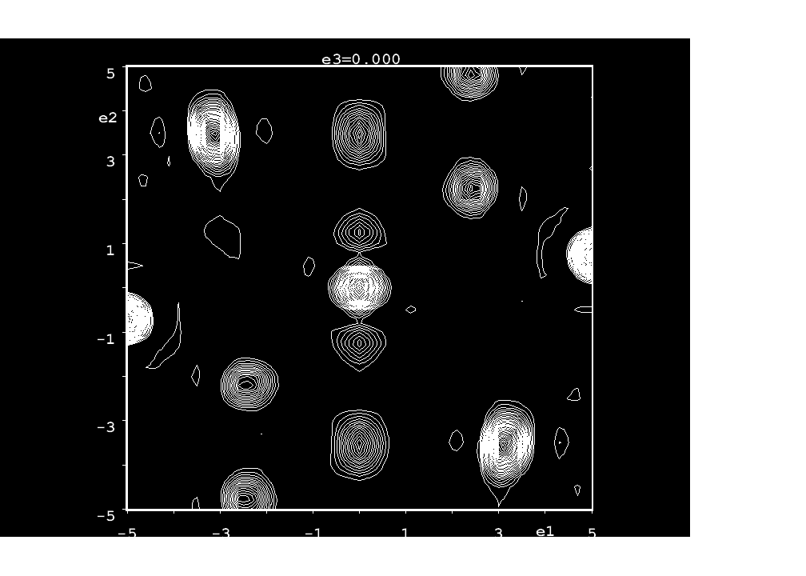
Exchange mechanism II
Tb
Nd

Slide 58
Exchange mechanism II
Mechanism II causes the symmetry lowering P6₃/mmc to P6₃mc
It boosts Zn content further.
As occupancy of this position approaches 1/3, the next ordering kicks in

Slide 59
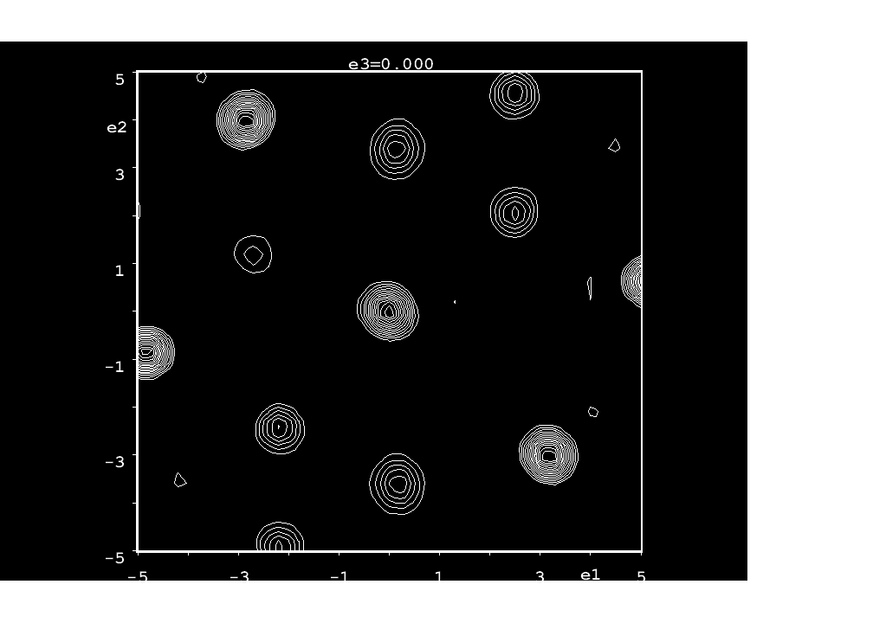
For fully ordered mechanism II, symmetry is reduced to P2₁. This applies to Gd and Tb. For Er, Tm, Lu addititonal disorder allows Pc2₁n.
Er
Tb (I)

Slide 60
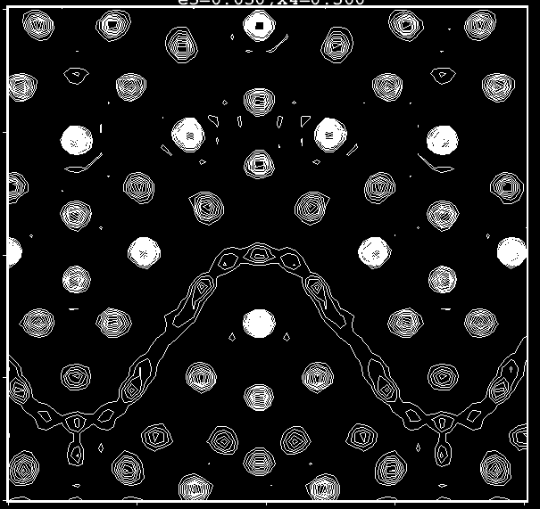

Slide 61
Special cases
Dy shows neither of the above mechanisms, but has an ordering all of its own.
Ho is very similar to Er and Tm but the additional disorder in the latter is resolved

Slide 62
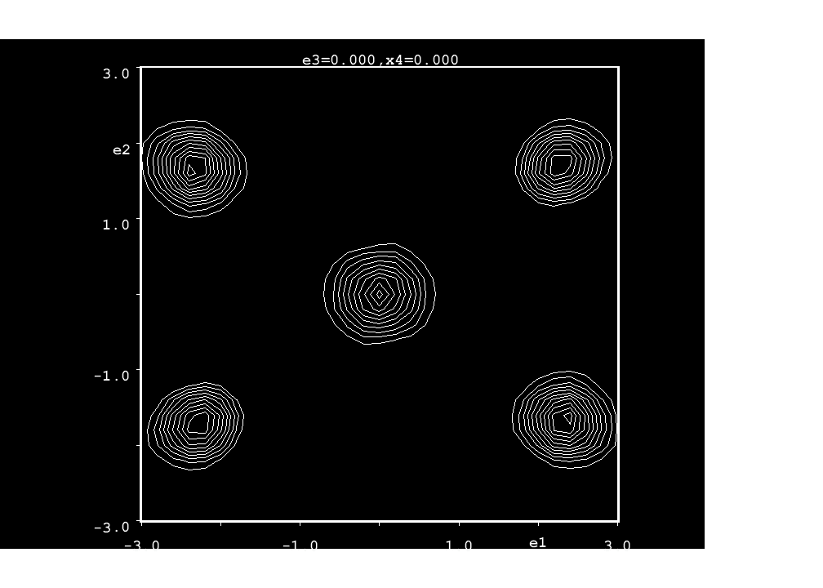
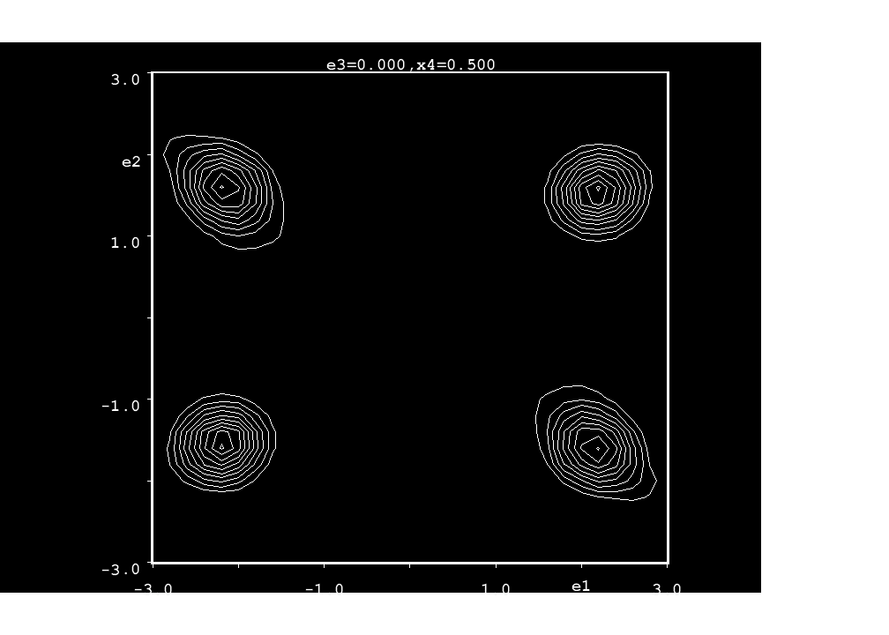
Dy and exchange mechanism III

Slide 64
Back to the Bad

Slide 65
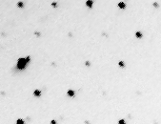

Remember Ce₁₃Cd₅₈
hk0 hk1
This structure contains 32 independent positions.
The superspace group is Amma(00g)s00

Slide 66


Exchange mechanism I

Slide 67
Exchange mechanism II

Slide 68
Exchange mechanism III

Slide 69
Put it all together

Slide 70
Examples
1 Zn_{3-x}Sb₂
2 Stistaite
3 Onoratoite
4 Ba₂Cu₂Te₄O₁₁Br₂ and Ba₂Cu₂Te₄O_{11-d}(OH)_{2d}Br₂
5 Ca₂₈Ga₁₁
6 Re₁₃(Cd/Zn)_{~58}
7 ReGe_{2-x}

Slide 71



More AlB₂:XY_{2-q}
AlB₂ – P6/mmm - Cmmm
-
Yb₃Ge₅ – P62m – Cm2m
q= (1/3 0 0)
R₅X₈ – Pbam
q=(2/5 0 0)

Slide 72
ReGe_{2-x}
The centering condition should allow for the C-centering of the parent AlB₂, but also for the primitive cell of the 5:8 compound.
α=0: hklm ⬄ hkl => h+k=2n
α=1/3: hklm ⬄ 3h+m k l => 3h+m+k=2n
α=2/5: hklm ⬄ 5h+2m k l => 5h+2m +k =?
This shows that the m component is involved in the centering: h+k+m=2n

Slide 73
ReGe_{2-x}
The a-glide ┴ b is present even without the C-centering.
This must be generated by an s-glide ┴ b =>
The superspace group is Xmmm(α00)0s0.
In many known compounds the q-vector takes the form
q=(α0γ) =>
The super space group must then be a subgroup of
Xmmm(α00)0s0 => X2/m(α0γ)0s

Slide 74
Composition
The commensurate cases indicate that the composition is given by the q-vector according to ReGe_{2-αx}.
Every second Ge atom is removed from a number of rows deteremined by q_{x}.
The limiting case is represented by Tm₂Ge₃ and Lu₂Ge₃, q_{x}=½.

Slide 75

Limiting case
R₅X₈ – Pbam
q=(2/5 0 0)
Tm₂Ge₃ – Pbam
q=(½ 0 0)

Slide 76

Example – Lviv
q>0.4

Slide 77


Example – DyGe_{2-x}
q<0.4
q>0.4

